Slide 1
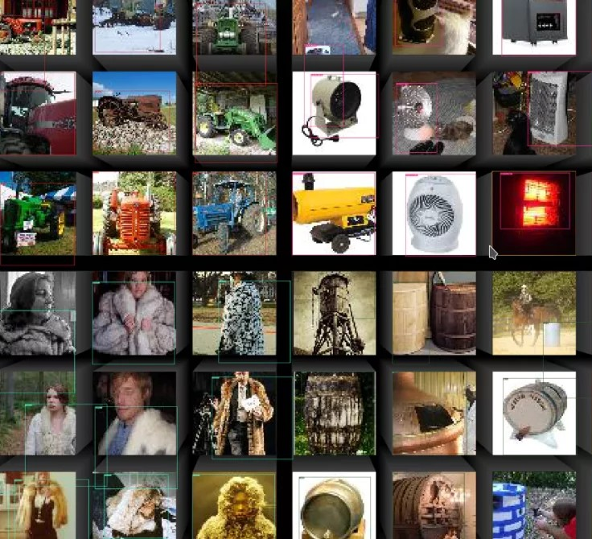
TinyImageNet Classification
INFO6147 Deep Learning with Pytorch
Mohamed Ali
Fall 2024

Slide 2
Outline
Dataset Description
Objective
Methodology
Results

Slide 3
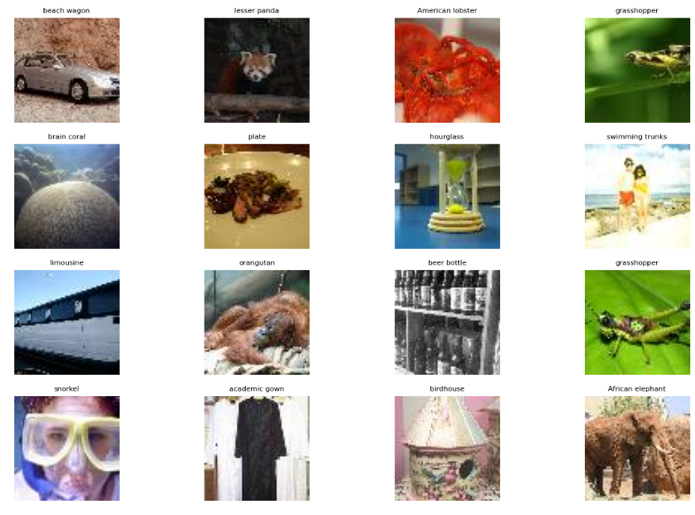
Dataset Description
Sample images
200 classes
Colored images
500 images per class for training
Image size is 64x64
10k images for validation

Slide 4
Objective
Create an image classifier for TinyImageNet Dataset
Initially the target is to get get good accuracy without data augmentation

Slide 5
Methodology
Different CNNs were designed to achieve the target
Models design:
Model 1: 8 conv layers, max pooling after each 2 and 3 FC layers for classification
Model 3: 8 conv layers, max pooling after each 2 convs, after the second and third maxpool there are FC layers and then there is the final 2 FC layers for classification
Model 4: this model has more channels in the convolutions and 6 FC layers for classification
Mode 4.2: based on model 4 but with added mid classifier (y value) that is summed with the final FC
Model 5: 16 convs and 4 FC layers for classification
Model 6: building on model 4 but adding an inner classifier after the 6th conv, the value of the middle FCs are summed with the later FCs to get better results.
Model 7: based on model 4.2, using Adpative pooling as instead of FC layers in the middle to add results to the final FC
Resent18: resnet was used at the end to see performance between models

Slide 6
Methodology
data augmentation methods included:
Creating a random 5% zeros tensor (rest are ones) and multiplying that random tensor with the input image at every epoch. The tensor is changed at every epoch (adding noise)
Creating variation of the training set (rotate 90,45,25,65 deg and their horizontal flips) this makes the training set 800k images. (it was very sow to train on this so used next one)
Creating horizontal and vertical flip of the original image

Slide 7
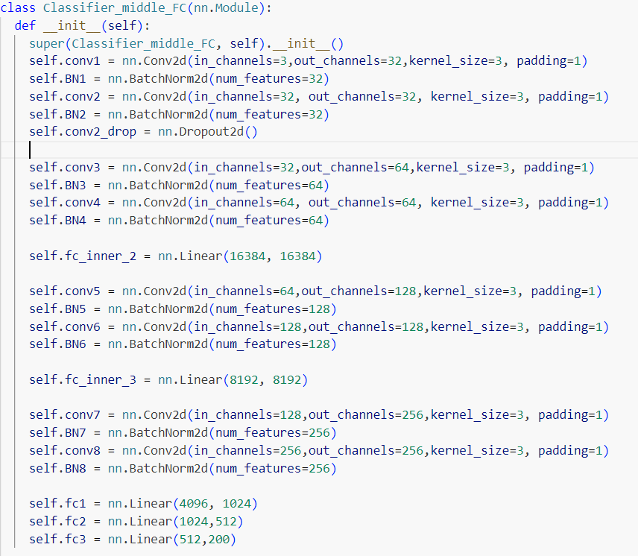
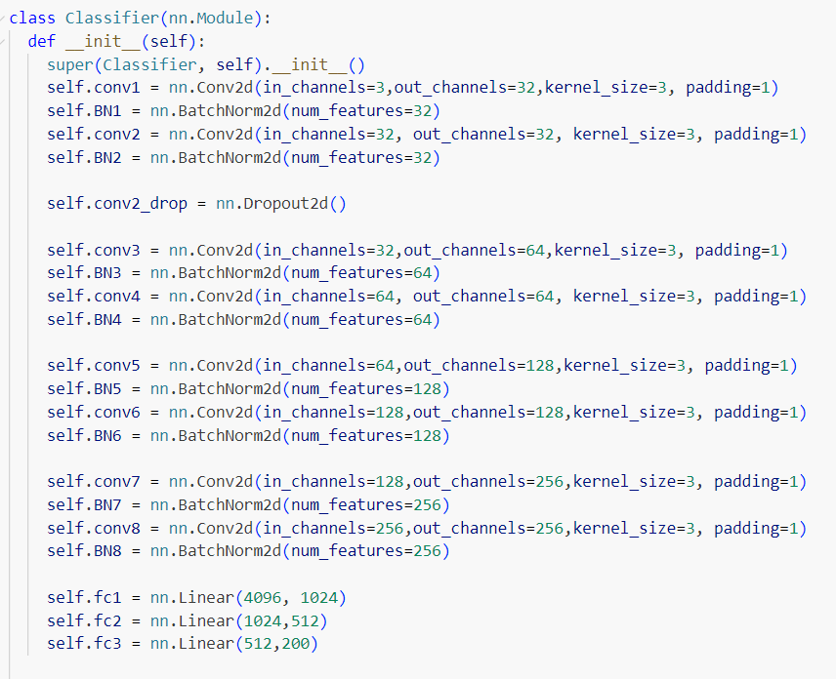
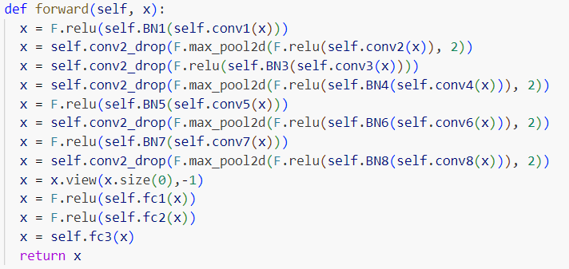
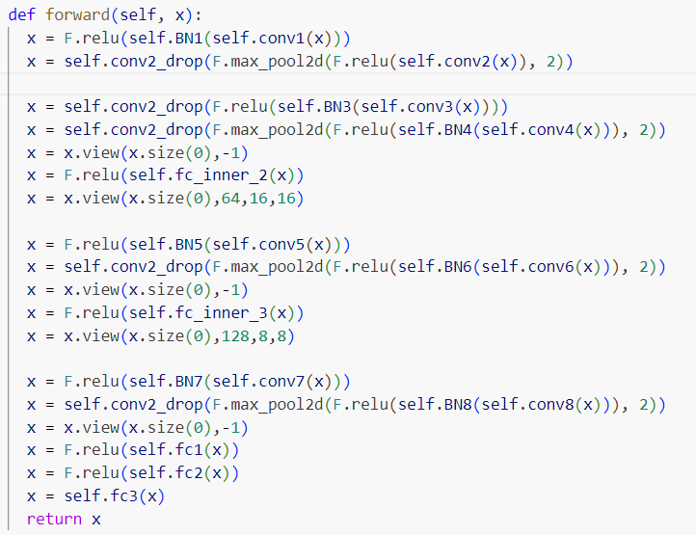
Classifier 1 & 2
Clf 1: 14% acc @30 epochs
Clf 2: 10.3% acc @30 epochs
Results(loss and accuracy was not saved)

Slide 8
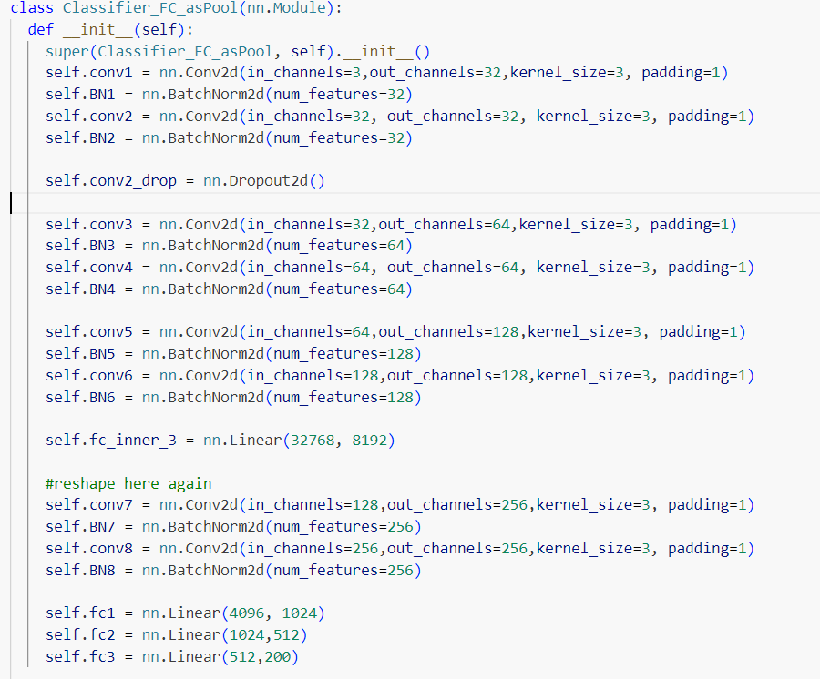
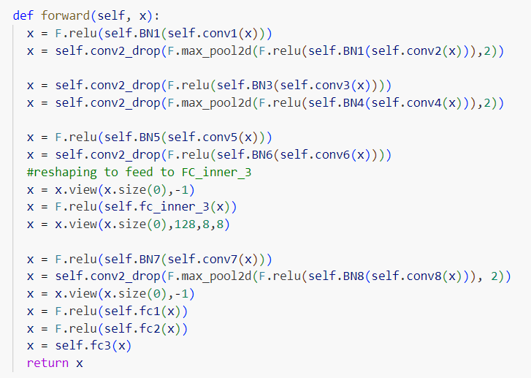
Classifier 3
Clf 3: 11.8% acc @30 epochs

Slide 9
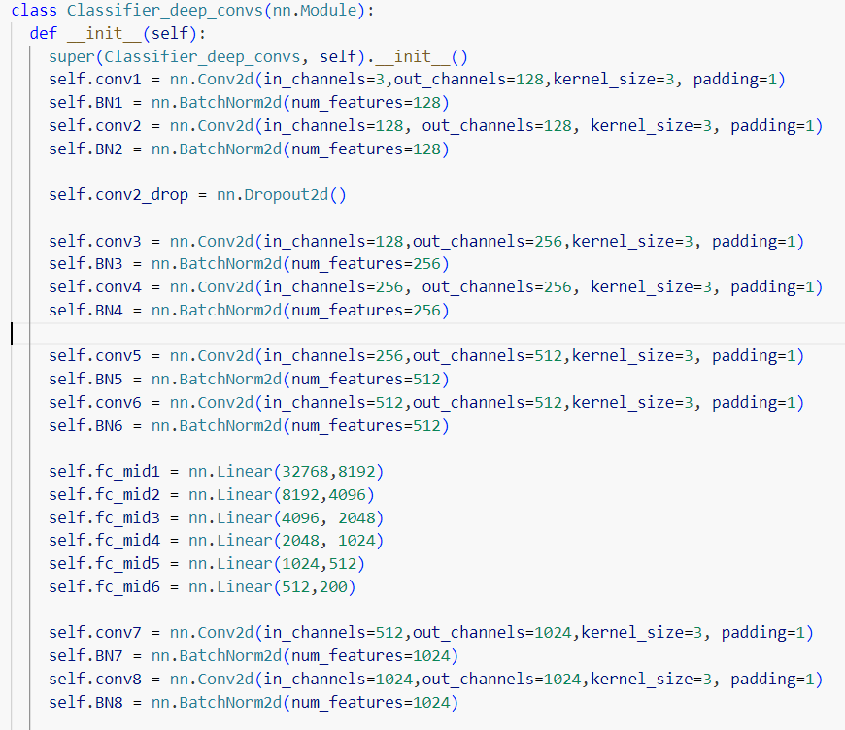
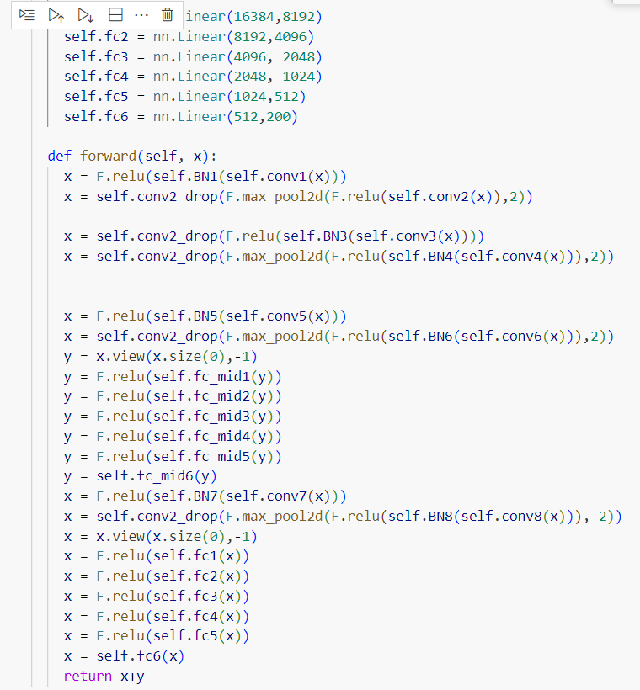
Classifier 4 & 4.2
Clf 4: 27% @30 epochs
Clf 4_2_Y: 28.6% acc @18 epochs
With DA method 1 accuracy was 24%
With DA method 2 accuracy was 10% at 4 epochs
Clf 4_2: 28.6% acc @18 epochs

Slide 10
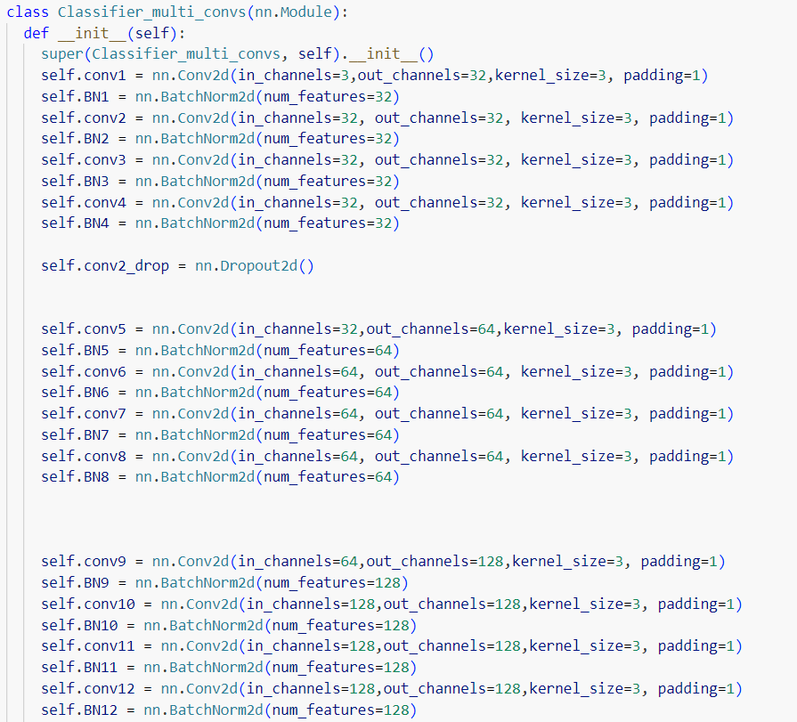
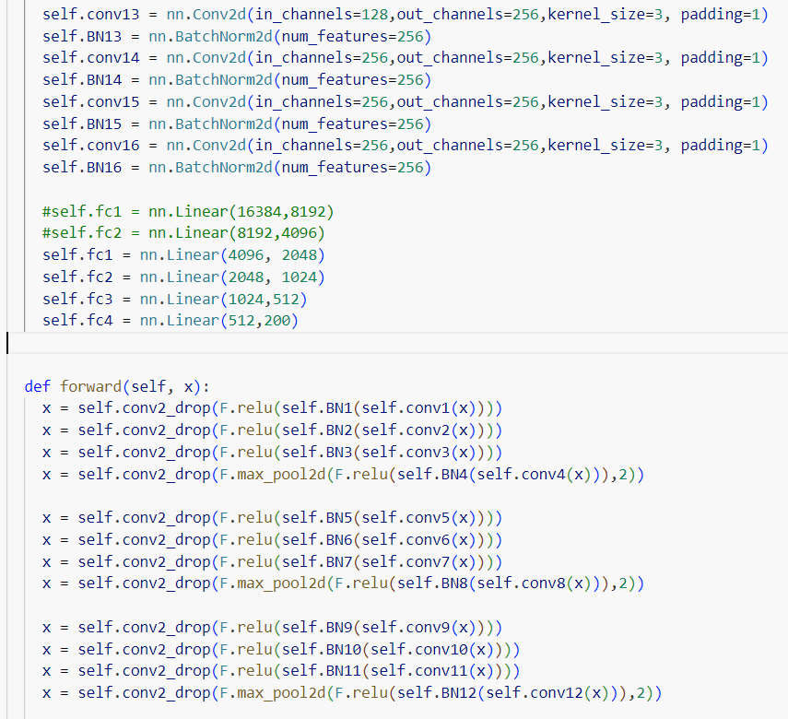
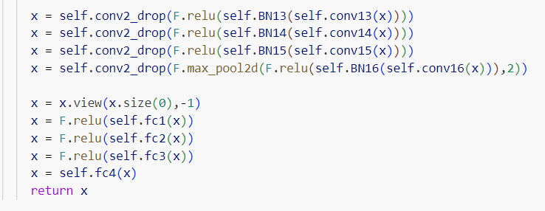
Classifier 5
Clf 5: Deeper network but 10% accuracy @30 epochs

Slide 11
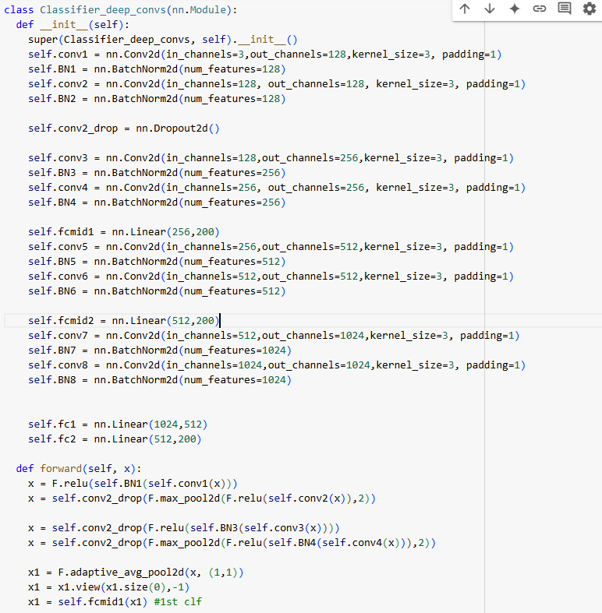
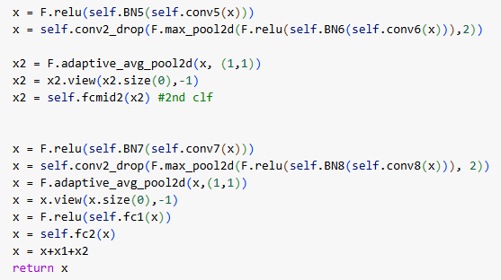
Classifier 7
Clf 7: build based on clf4_2 but instead of mid FC layers that are big,
adaptive Avg pooling was used and smaller FC was created in between as middle classifiers. It made the parameter size much less and computation faster
25.9% acc at 21 epochs

Slide 12
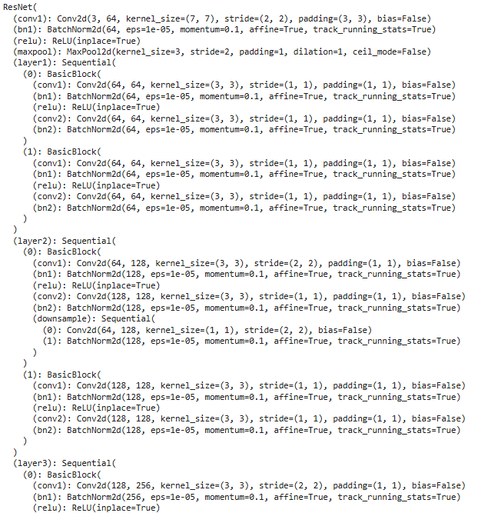
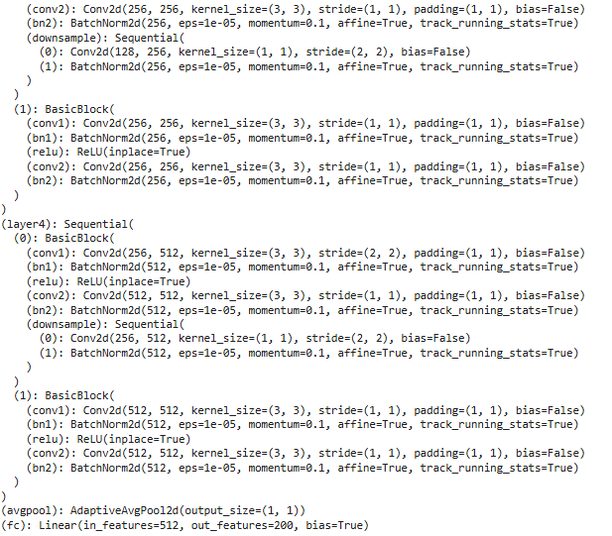
Resnet18
Resent18: the model was used and trained from scratch
23.6% acc at 30 epochs

Slide 13
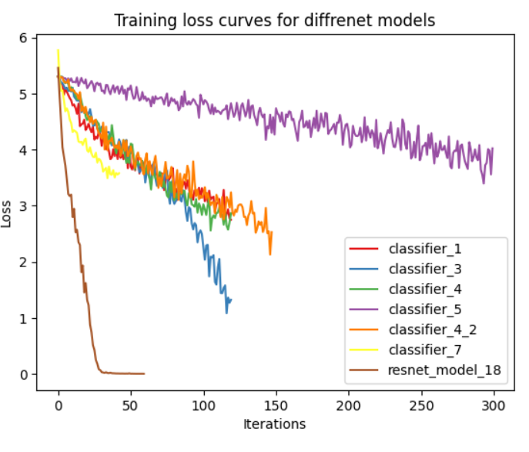
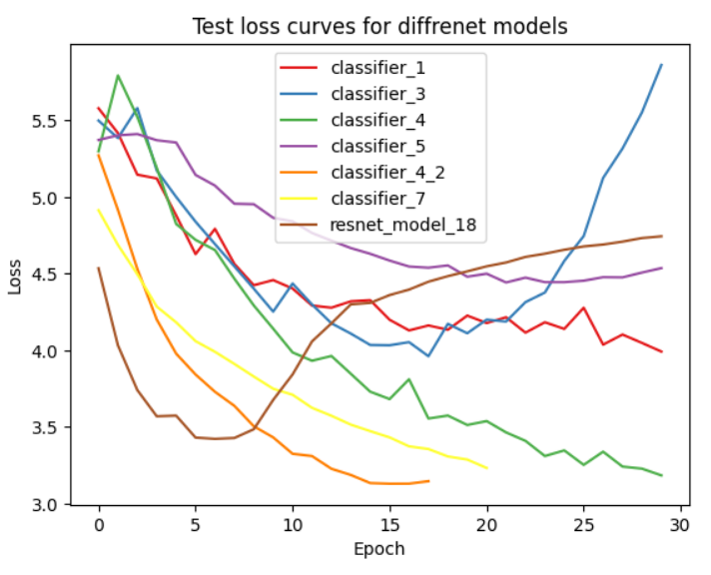
Results
The test loss for some of the models indicate over fitting
Resnet was the fastest drop of training of loss value and re-increase in test loss

Slide 14
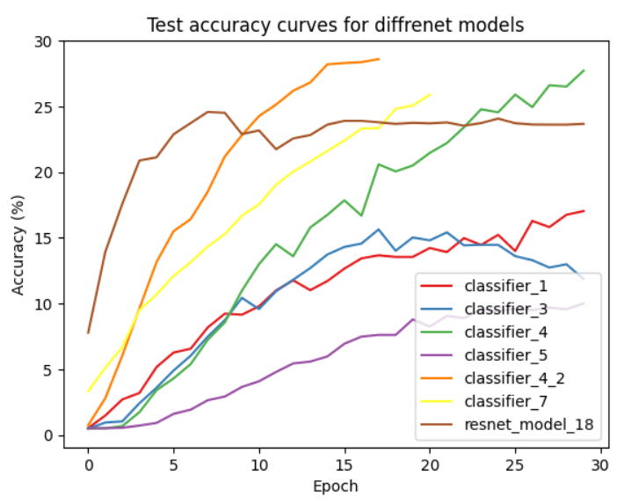
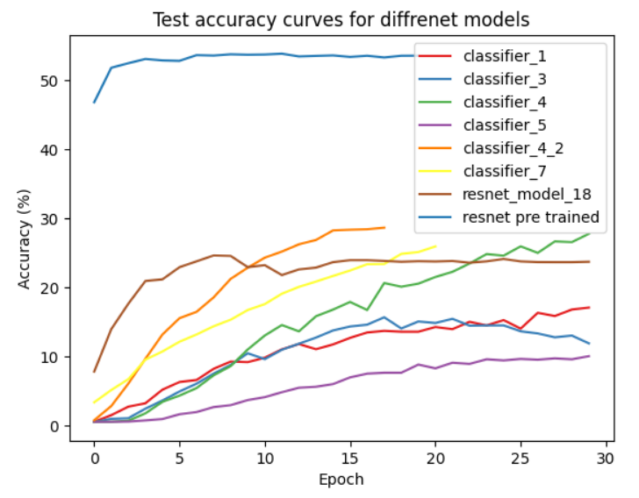
Results
We can see that 3 of the created models performed better than resent but at a later epoch (Clf4, 4_2 and Clf7)

Slide 15
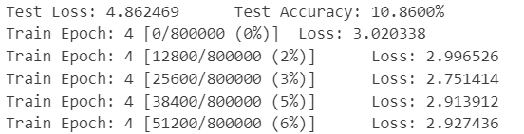
Conclusions
We can obtain acceptable accuracy without data augmentation)
Due to the number of classes, using multiple variations on the training images produces many images to train which takes a very long time to train and due to resources I could not produce results from that.
Further work can be done to improve the model design and think of other architectures.

